Slide 1
Tiffin Ordering System (Bunny Chow)

Slide 2
Agenda
INTRODUCTION 3
LANGUAGE USED 4
OBJECTIVES OF PROJECT 8
WORK FLOW 9
SNAPSHOTS 10

Slide 3
Introduction
The project titled “Tiffin Ordering System” is a desktop application which is created to help small scale Homemade food businesses/mess and small hotels to manage and
control their business through online platforms. This project provides ease to them to keep the records of all the customers as well as orders given to them. It allows to keep a check on payment made by customers. It also manages the record of ad-
min and employees working in the business.
This project has been made keeping in mind the requirement of the company which saves their time and also help them to
keep a safe record handling.

Slide 4
LANGUAGES USED

Slide 5
Front End- Java
Java is an object-oriented programming language that allows engineers to produce software for multiple platforms.
It is used for Mobile applications (specially Android apps),Desktop applications, Web applications, Web servers and application servers, Games and Database connection.
A Java application is a standalone Java program that can be executed independently.

Slide 6
IDE- NetBeans
NetBeans is an open-source, freely available development environment used to develop desktop application, web application, and mobile application.
NetBeans is integrated with drag and drop features which support almost all the GUI based framework to design the interface using these framework.
It is used to reduces/ avoids the complexity and unnecessary iterative task

Slide 7
MySQL(My Structured Query Language)
Relational database management system based on SQL.
Provides for how to manage database with the help of various SQL queries such as insert , update , delete & select records, create tables etc.
Platform flexibility is a feature of MySQL with all flavors of Linux, UNIX, and Windows.

Slide 8
Objectives Of Project:-
This Application provides facility to order home-made food .
Quick ordering process with minimum delays because chef gets the order as soon as customer place the order. It is automatically generated by the server.
Administrator has a privilege to control the business by having digital reports.
User can register, login and buy the meals with his specific id, and can see the total amount of his purchasing as well.

Slide 9
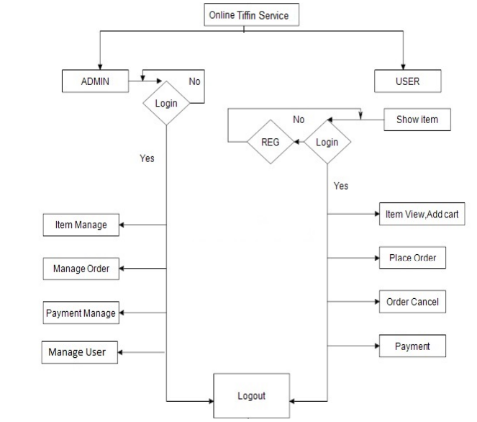
Work Flow Of APPLICATION

Slide 10
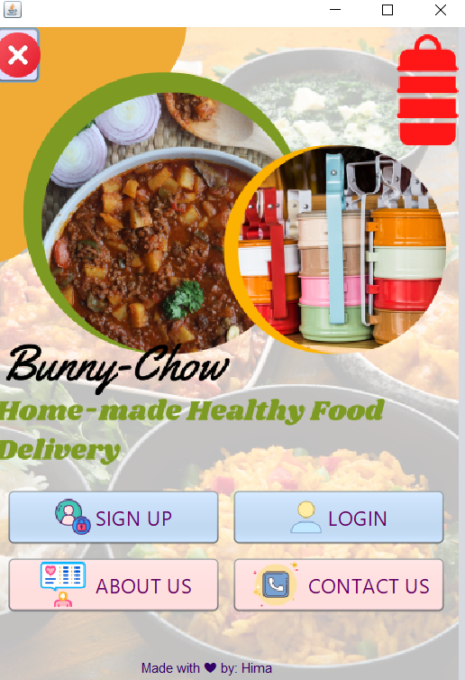
SNAPSHOTS
Front Page
Tiffin Ordering System
10

Slide 11
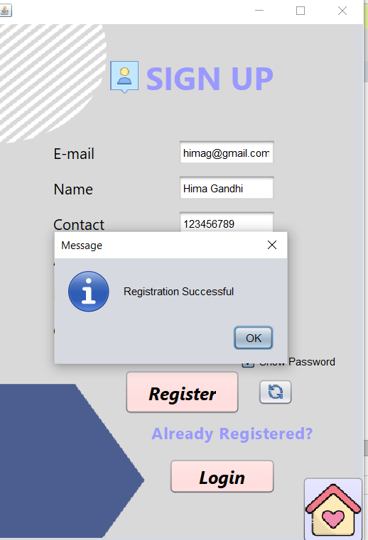
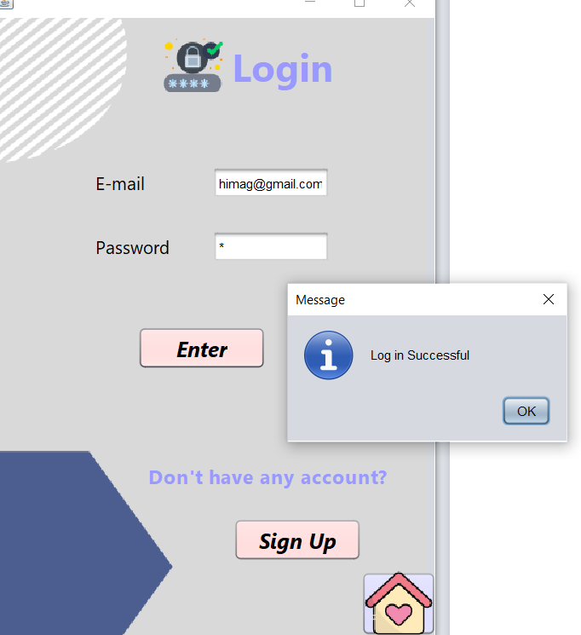
SIGN UP
LOGIN

Slide 12
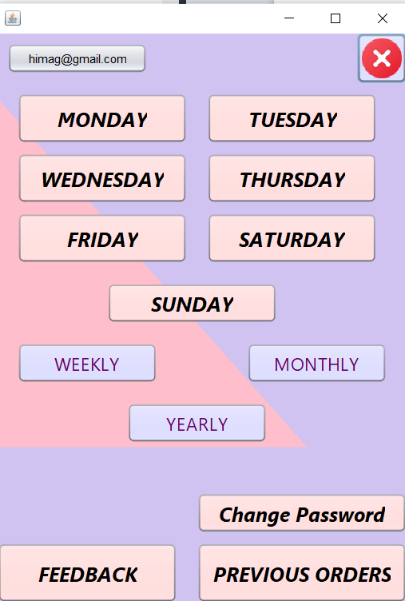
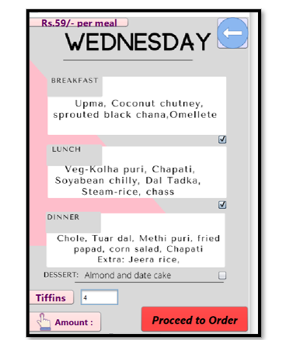
USER HOME-PAGE
ORDER

Slide 13
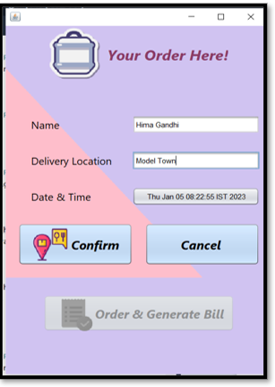
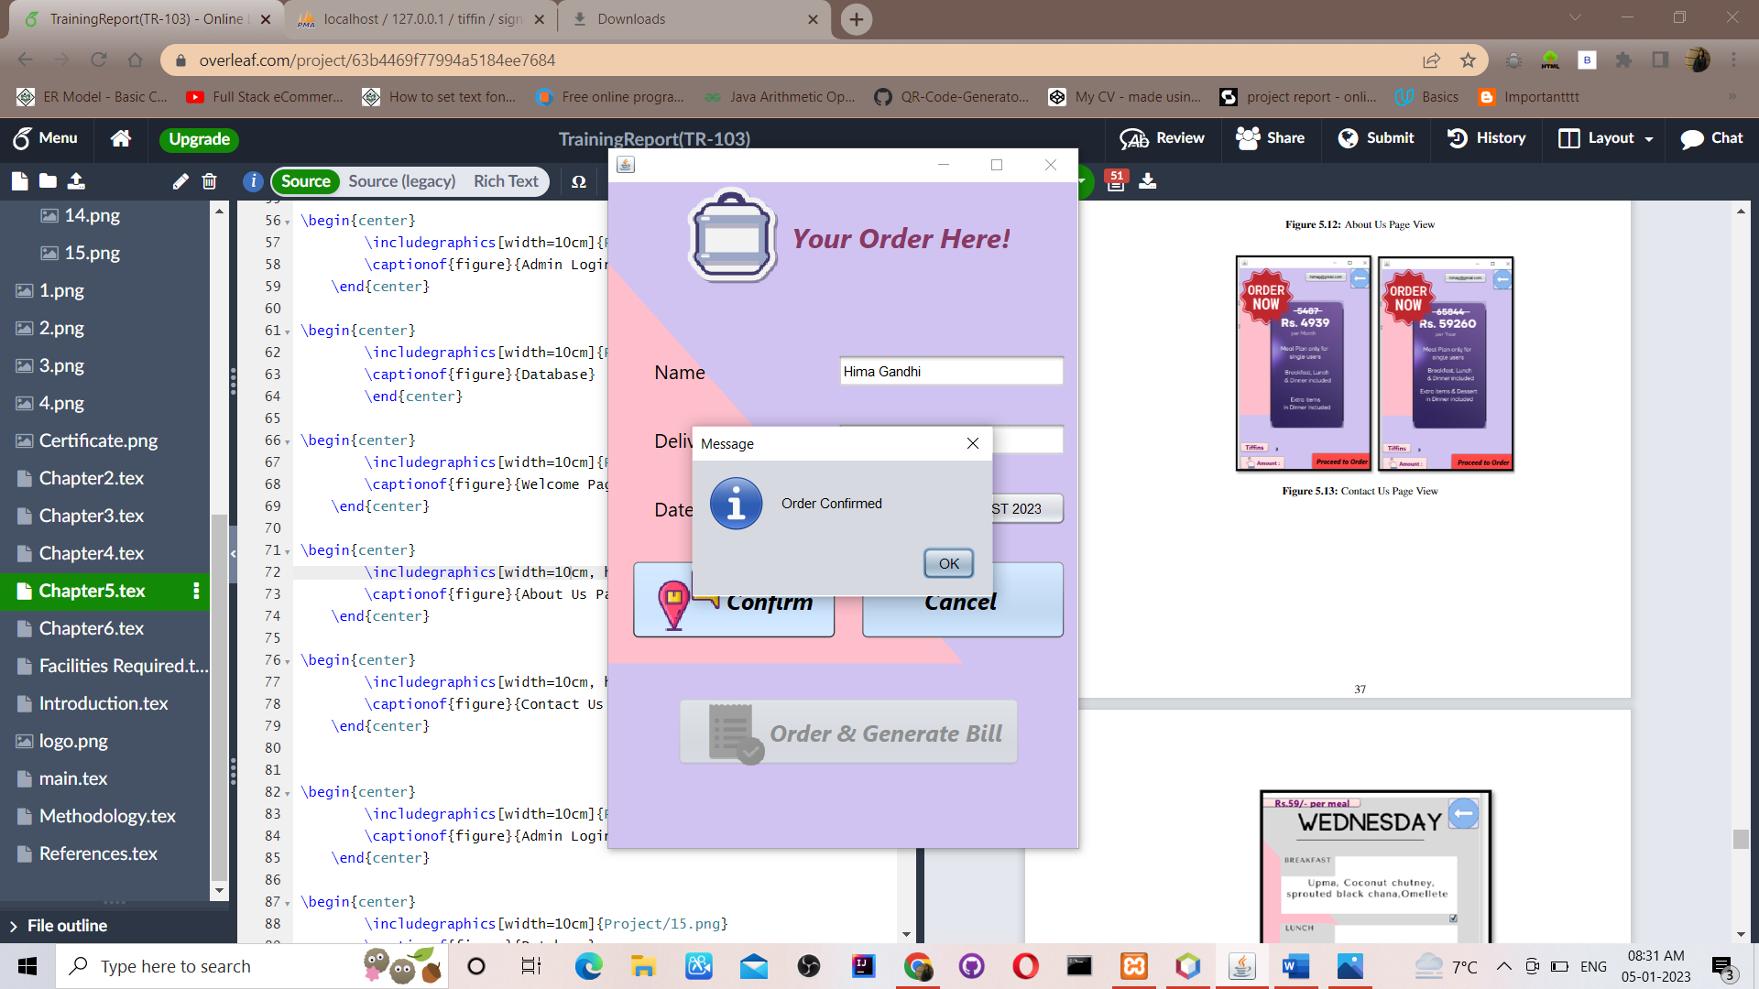
ORDER PROCESS
ORDER CONFIRM

Slide 14
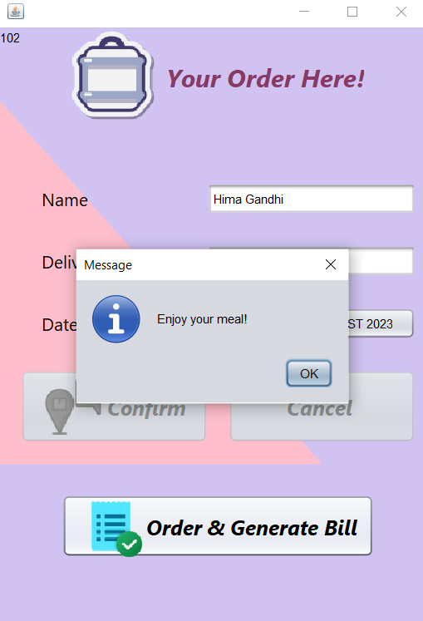
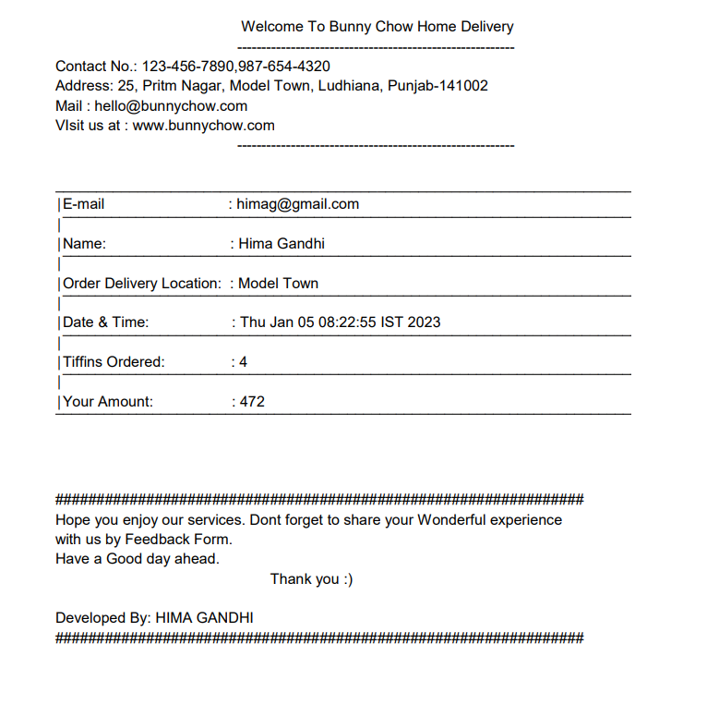
ORDER PROCESS
ORDER PDF

Slide 15
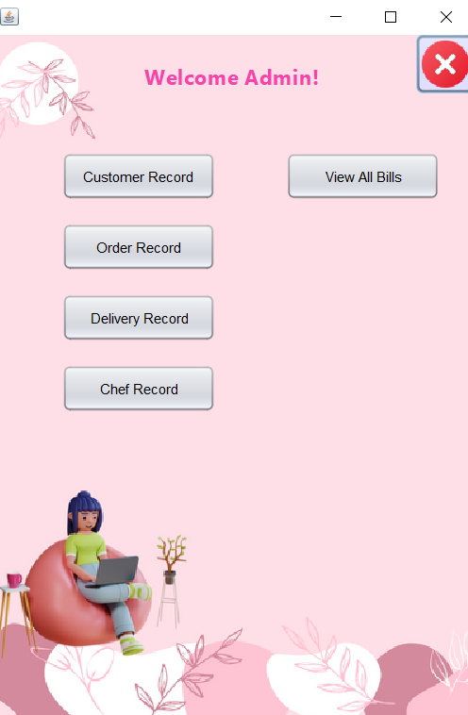
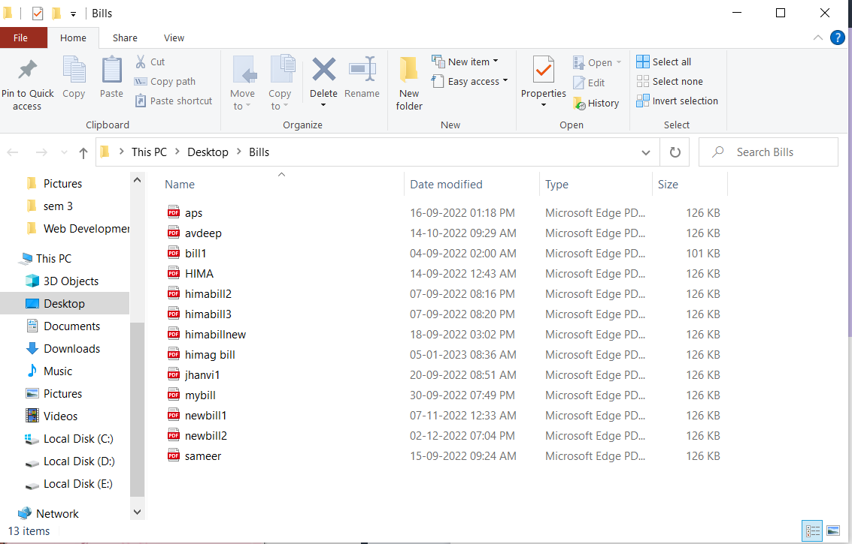
ADMIN ACCESS
VIEW BILLS FOLDER

Slide 16
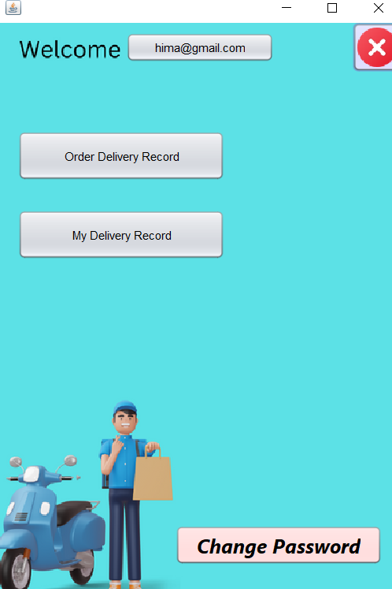
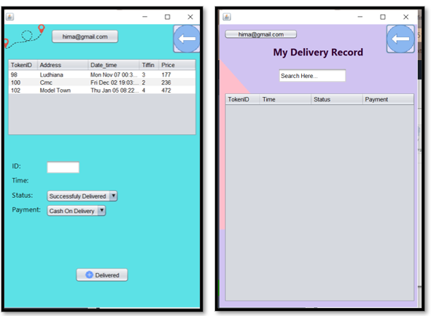
EMPLOYEE ACCESS & RECORD

Slide 17
Thank you !
PROJECT BY:
HIMA GANDHI (1905339)
Branch: Information Technology
Guru Nanak Dev Engineering College

